Slide 1
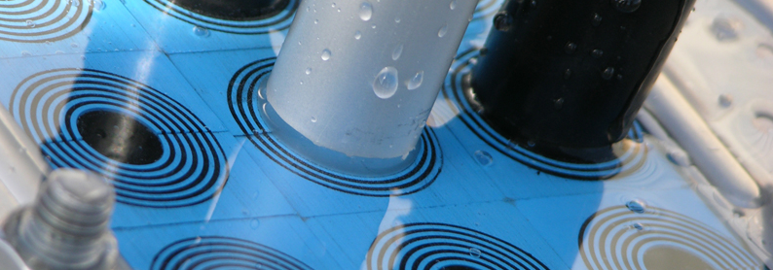
Transit Designer
Mattias Persson 2013-03-19

Slide 2
What will I show today
Background
Mission
Transit Designer, Key features
Demo
Timeline / Activities
Notes:
Vision 10min

Slide 3
Background
Current Software RTM 3
Drastically decrease the design time for cable and pipe transits
+ Calculate the Area needed to incorporate the cables
+ Generate drawings for installation
+ Generates lists of used components for purchasing in PDF
But…
- Unstable software, hard to install and update
- We don’t know who is using it and to what extent
- Customer need to know all about our products and vocabulary
- Not very user friendly

Slide 4
Project mission
To take our current RTM technology and make it an
Accessible world class tool.
By incorporating key features and by making it easy to access and use, we make sure that Roxtec is the preferred and most cost efficient solution for pipe and cable transit design.
Primary target users are EPC customers.
Notes:
Sänka antalet mantimmar hos oss och hos kunden.

Slide 5
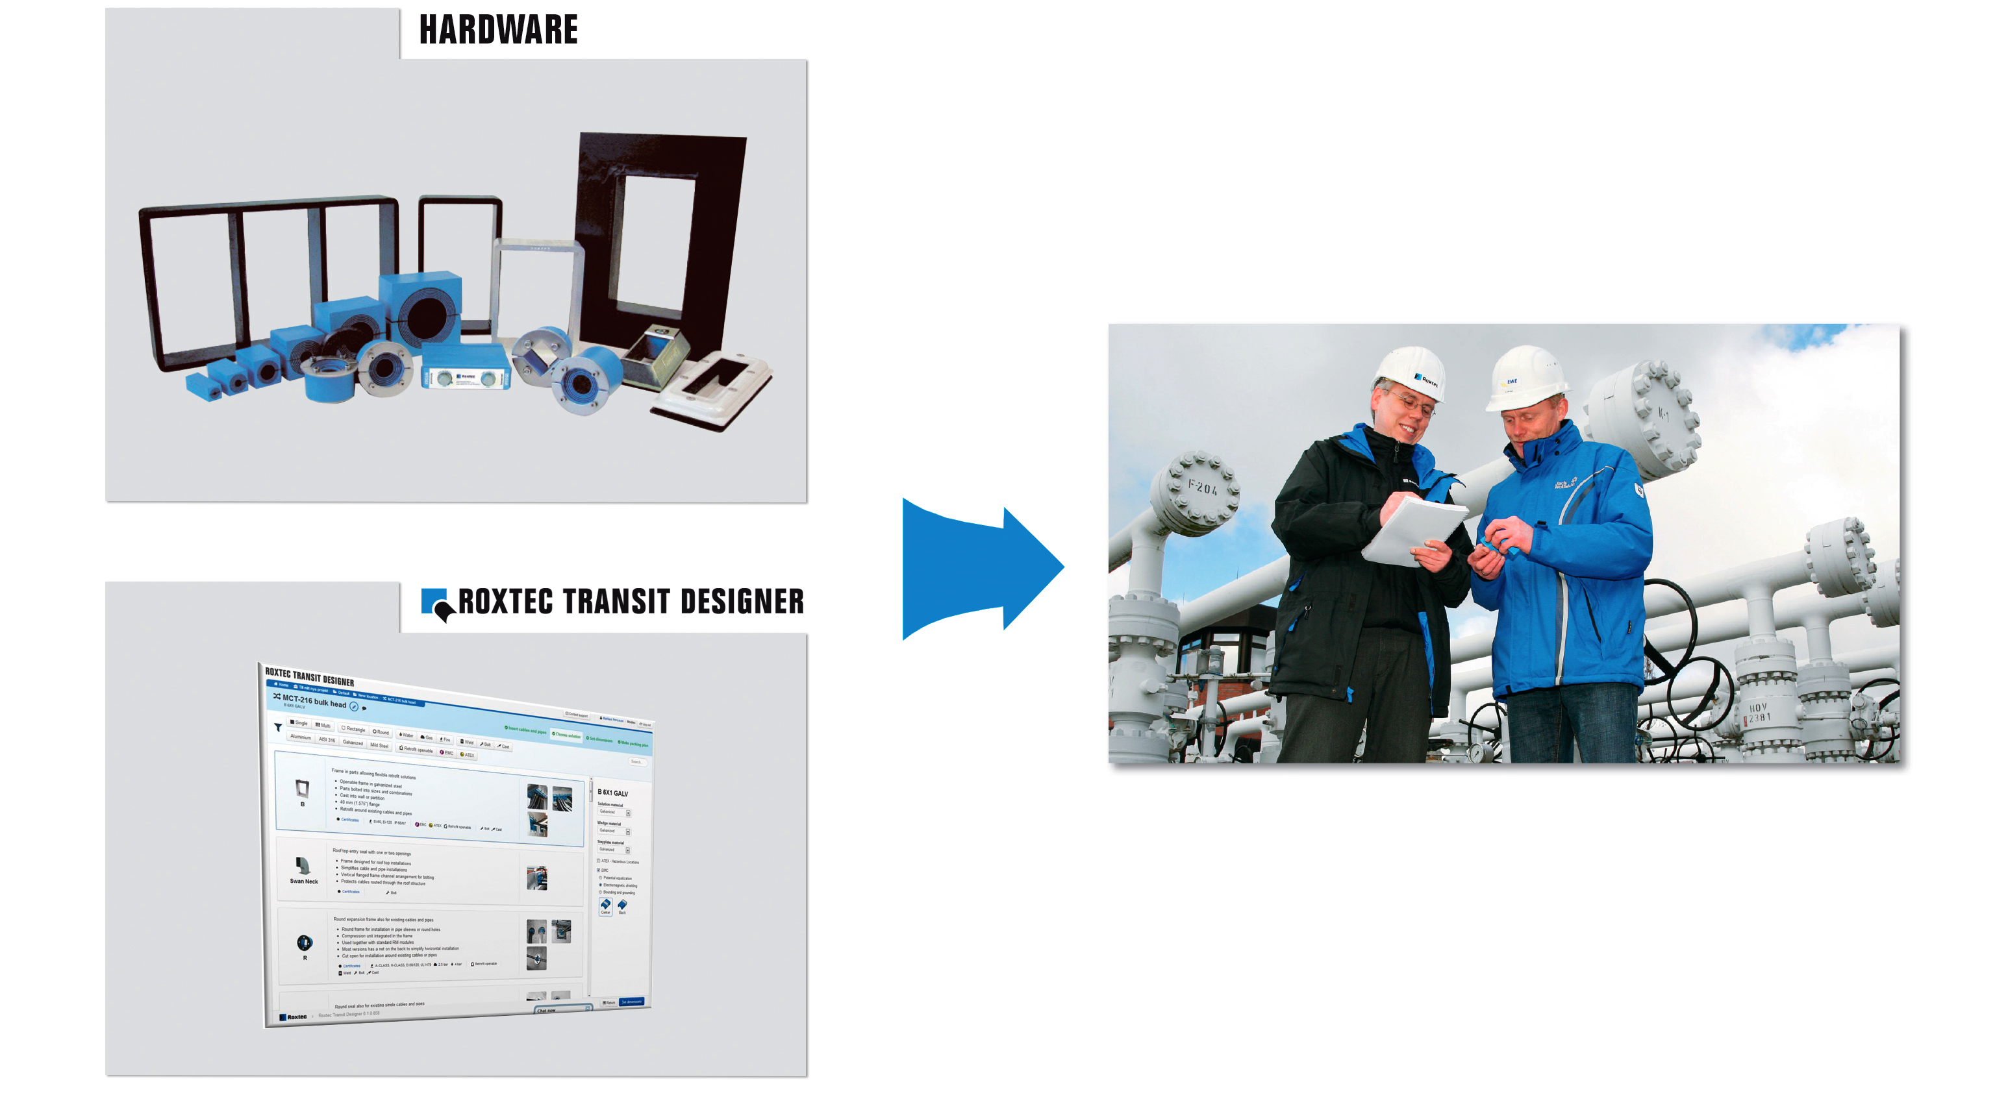
Additional value offering --Signficant time savings--
Notes:
Sänka antalet mantimmar hos oss och hos kunden.

Slide 6

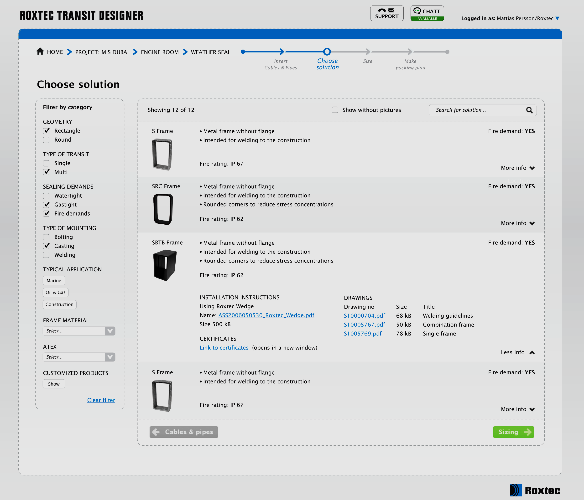
Customer scenario
Customer input
Software Output
Excel file,
Cable list or
Prel estimations
2D transit drawings
in DXF and PDF
3D model of frame
Transit demands
Fire resistans IP EMC, Cert etc
Excel files,
BOM, both for printing and straight lists
Mounting preference,
Sometimes needs to match an existing hole
Installation Instructions

Slide 7
Key customer features
We extend our email and phone support with Live chat
Streamlined work process
Realtime editing of cable schedule with paste from excel functionallity
Guide through the Roxtec product range depending on cables/pipes
A visual sizing engine to help to browse and size our products.
A visual drag and drop interface to place the modules in the frame
Instant generation of drawings and other related documents.
Zero footprint installation client (SAAS)
Easy collaboration globally

Slide 8
Roxtec internal key features
Complete monitoring of customer usage
Easy collaboration
Addition of new products get implemented in real time to all users.
New communication channels with customers with chat and news and events
Streamlined internal process for quotes with IFS integration

Slide 9
DEMO

Slide 10
Key customer features
We extend our email and phone support with Live chat
Streamlined work process
Realtime editing of cable schedule with paste from excel functionallity
Guide through the Roxtec product range depending on cables/pipes
A visual sizing engine to help to browse and size our products.
A visual drag and drop interface to place the modules in the frame
Instant generation of drawings and other related documents.
Zero installation client (SAAS)
Easy collaboration globally

Slide 11
Roxtec internal key features
Complete monitoring of customer usage
Easy collaboration
New communication channels with customers with chat and news and events
Streamlined internal process for quotes with IFS integration

Slide 12
Roxtec internal key features
Complete monitoring of customer usage
Easy collaboration
Addition of new products get implemented in real time to all users.
New communication channels with customers with chat and news and events
Streamlined internal process for quotes with IFS integration

Slide 13
Timeline – RTD Launch
MD Introductions
RTD training to local sales & support colleagues via Lync with Mattias
Client GO LIVE June 1, followed by Global Segment training and client visits with local sales teams.
March-April 2013 | March-May 2013 | June-September 2013

Slide 14
Thank you!

